Slide 1
Meeting 07/09/2020
Naudé Conradie
19673418

Slide 2
CPPNs
Model number control
Functions are applied per layer
Percentage of elements is kept
Symmetry problem solved
Incremented seeds are applied
Layer size is dependent on final resolution
Hidden vector size only used to generate unique starting vector

Slide 3
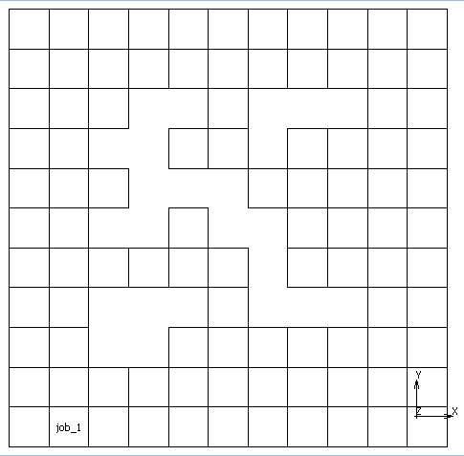
CPPN Example
Variables | Values
Number of models per CPPN | 5
Number of layers | 10
Size of initial layer | 20
Scale | 1
Seed | 11
Percentage of elements kept | 50
Model ID | 3

Slide 4
Genetic Algorithms
Modification | Variables | Value
Crossover | Points | 2
 | Probability | 0,9
Mutation | Points | 2
 | Probability | 0,1
Biased mutation | Points | 2
 | Probability | 0,5
Points are prioritized over probability
Biased mutation
Value is shifted up or down by 1

Slide 5

Genetic Algorithms
Parent fitness evaluation
$$f_{i}=\frac{2{\left(p+1−i\right)}^{c}}{p^{2}+p}$$
Where
$f$ is the relative fitness of the parent
$p$ is the population size
$c$ is the fitness function constant, usually 1
$i$ is the rank of the parent

Slide 6
Genetic Algorithms
Generation Method | Number Of Variables | Variables | Fitness
Random | 2 | Number of elements removed | Maximize to a point
 |  | Element locations removed
L-System | 5 | Axes of symmetry
 |  | Number of grammatical rules | Minimize to a point
 |  | Length of rules | Minimize to a point
 |  | Rule units
 |  | Iterations | Minimize to a point
L-System rule units
"F", "f", "+", "-", "++", "--", "fF", "Ff", "[F]", "[f]", "[+F]", "[+fF]", "[-F]", "[-fF]“

Slide 7
Genetic Algorithms
Generation Method | Number Of Variables | Variables | Fitness
CPPNs | 7 | Number of models per CPPN
 |  | Number of network layers | Minimize to a point
 |  | Size of initial layer | Minimize to a point
 |  | Scale
 |  | Seed
 |  | Percentage of elements kept | Minimize to a point
 |  | Functions applied to each layer
Overall fitness evaluation
Minimum constraint energy
Minimum strain energy

Slide 8
Genetic Algorithms
Fitness evaluation
Rank according to minimums in ascending order of importance
Boundary conditions and loadcases
Unique modification
Random
Element locations removed
L-Systems
Rule units
CPPNs
Functions applied to each layer

Slide 9
Admin
Journal
Specific journal
Content
Entire project
Single aspect
Style
Literature
Length

